Slide 1
SIP Basics and Beyond
洪胤勛

Slide 2
What is SIP (Session Initiation Protocol)
In the traditional circuit-switched system, telephones were required to have essentially the same set of capabilities
The mechanics of reaching them were based on their being at the end of a particular fixed section of copper wire

Slide 3
What is SIP (Session Initiation Protocol)
In the Internet-based systems, the phone can have a wide range of capabilities. ex. codecs
It helps two parties wanting to communicate find each other on the Internet
It allows those parties to negotiate how they are going to communicate

Slide 4
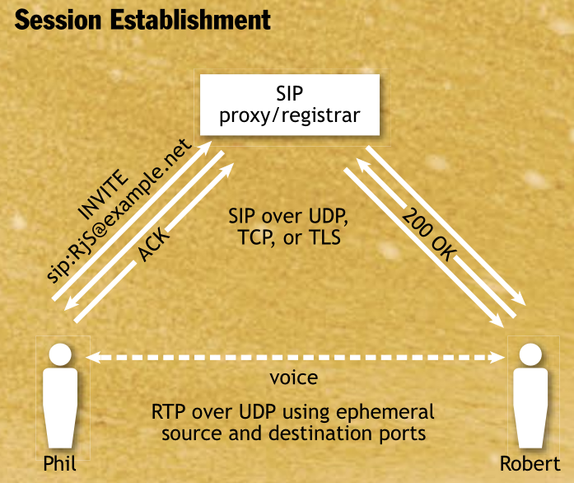
How SIP Works
SIP endpoints, also known as UAs (user-agents), can both generate and answer requests.
A proxy/registrar is an endpoint when handling registration and an intermediary when forwarding requests
Note that the SIP signaling and the media traverse the network independently

Slide 5
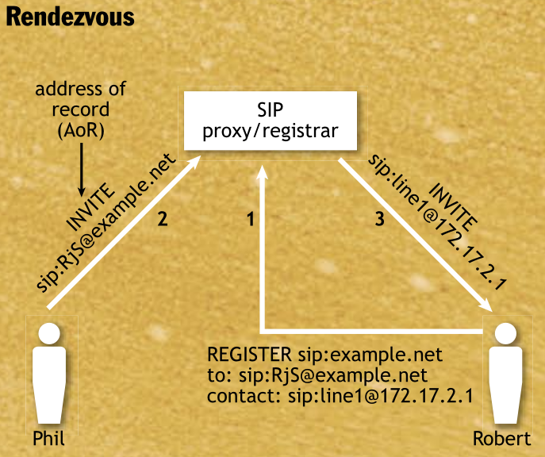
How SIP Works
Rendezvous is established using these proxy/registrars and is based on users having a well-known AoR (address- of-record)

Slide 6
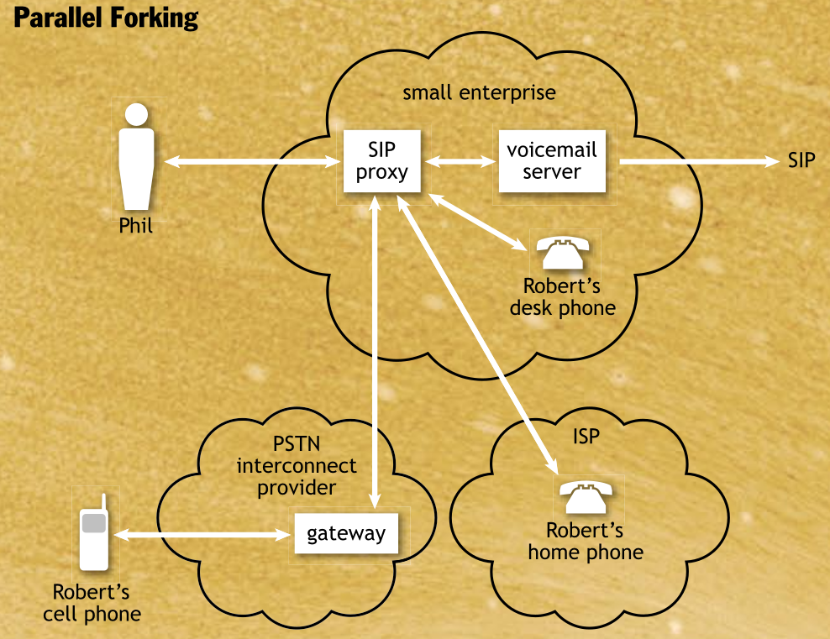
How SIP Works
More than one endpoint can be registered with an AoR
With many deployed services, it will simply forward the request to each contact simultaneously (parallel forking), which is a primary source of power in SIP’s rendezvous function

Slide 7
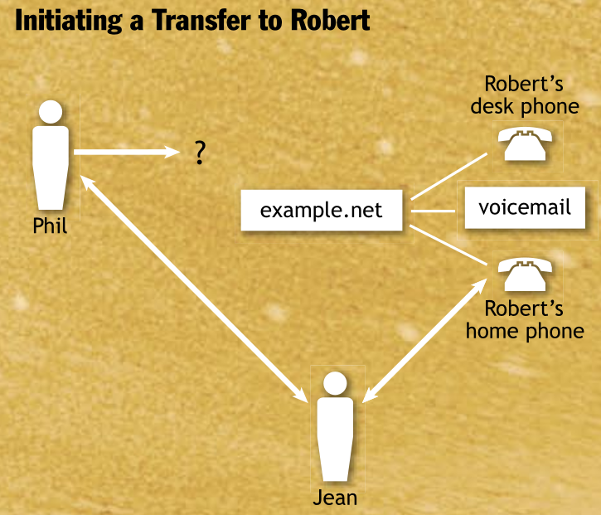
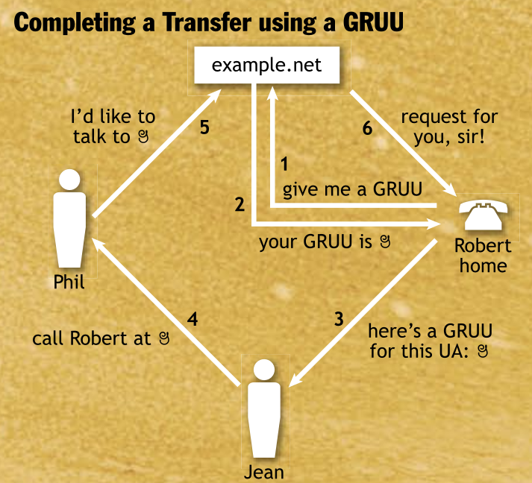
GRUUs (Globally Routable User agent URIs)

Slide 8
Current Issues
Communicating through NATs
SIP proxy/register
Invite B
Return IP, port
NAT
1
2
3
A
???
B
RTP 192.168.0.100
192.168.0.100
Solution: STUN, TURN, ICE

Slide 9
Current Issues
Emergency services
Providers of emergency services in the traditional PSTN network. They used the property that the calling phone was at the end of a ﬁxed, provisioned copper wire
On the Internet, there is no such luxury for identifying the calling location
In the IETF, this work is taking place in the ECRIT and GEOPRIV working groups
Thank you for your listening

Slide 10
Current Issues
Early media

Slide 11
Current Issues
Securing the signaling and media
SIP can be protected by using a secure transport such as TLS (Transport Layer Security) or DTLS (Datagram TLS)

