Slide 1
Secret Sharing
Branko

Slide 2
What is Secret Sharing
n = 5

Slide 3
What is Secret Sharing
k = 3
… >= 3

Slide 4
Why

Slide 5
Why
Manager
Leader
2 Manager
or 1 Manager 1 Leader
or 3 Leader

Slide 6
Shamir Secret Sharing (k, n)
Threshold: k
Degree of polynomial: k-1

Slide 7
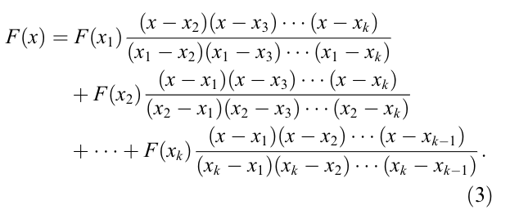
Shamir Secret Sharing Reconstruct
Lagrange Interpolating Polynomial method (拉格朗日插值法)

Slide 8
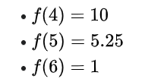
Shamir Secret Sharing Reconstruct
Lagrange Interpolating Polynomial method
(Binomial)
Find f(0)

Slide 9
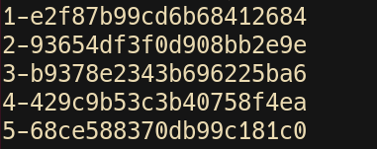
Demo (ssss)
Notes:
http://point-at-infinity.org/ssss/

Slide 10
Demo (ssss)
Notes:
http://point-at-infinity.org/ssss/

Slide 11
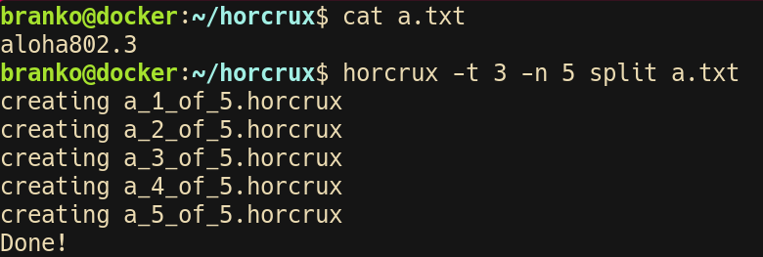
Demo (horcrux)
Notes:
https://github.com/jesseduffield/horcrux

Slide 12
Demo (horcrux)
Notes:
https://github.com/jesseduffield/horcrux

