Slide 1
洪胤勛

Slide 2
Intro
Load testing tool
protocol supported: HTTP/1.1, HTTP/2, WebSocket and gRPC
configuration: certificates, Cookies

Slide 3
Running
command option
JavaScript (不需要 Node.js)

Slide 4
Running
virtual users
Socket.IO
users are parallel

Slide 5
Running
exported default function
like C, main

Slide 6
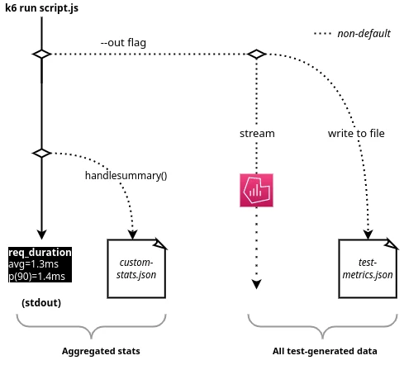
Output

Slide 7
Demo

