Slide 1
Secret Sharing
Branko

Slide 2
Problem Definition
secret sharing 需要一定的 sharing (threshold) 才能湊回去
  要如何確保在分享這些 sharing 時不會被攻擊

Slide 3
Motivation
單一個 secret 的架構容易被破解, 破壞
  用 secret sharing
stego 在圖片容易被發現
  要把 sharing 藏在聲音中

Slide 4
Survey of previous work
secret sharing
stego (LSB)
  藏在圖片中
    https://www.sciencedirect.com/science/article/pii/S1319157821002603
  聲音 stego
    https://link.springer.com/chapter/10.1007/978-81-322-0740-5_83

Slide 5
Goal of your research
以 sharing 的方式, 來讓原本的 secret 不易被竊取、破壞
除了用 secret sharing 方式來保護本來的 secret 外, 在傳送 sharing 時也要讓別人不易察覺 stego (LSB)
  圖片的 LSB stego 容易被發現, 用聲音 stego

Slide 6
Background technology
secret sharing
  Shamir’s, Blakley’s
stego
  https://link.springer.com/chapter/10.1007/978-81-322-0740-5_83
recording (sample, frame, channel, rate)

Slide 7
System Architecture and Your Contribution
sharing
sharing
raw_data
stego_data
stego_data
wav_file
wav_file
TCP
sender
receiver

Slide 8
System Architecture and Your Contribution
receiver1
sharing1
wave1
sharing2
wave2
receiver2
sender
wave…
sharing…
.
.
.

Slide 9
System Architecture and Your Contribution
Channel = 1, Rate = 8000, Format = Int8
len = 12
1-0bf53ca7dd
0x00001100
8 * 12 Sample
8 Sample

Slide 10
Experimental Result / Performance Evaluation
PSNR
  https://ieeexplore.ieee.org/stamp/stamp.jsp?arnumber=7423320&casa_token=7Ls7ag0rebYAAAAA:w3QrKluJAtDzoFrNuZ_6nUGh2DfyYRBJG1fnR5KASZsF1y-qEP6XOyWsdvZe1hy-cfDybeIgpg&tag=1

Slide 11
Conclusions and Future Work
Feature Work
  使用 UDP, RTP 的封包來傳送
  把它包在電話裡面，在通話的時候就把 sharing 傳送過去

Slide 12
END

Slide 14
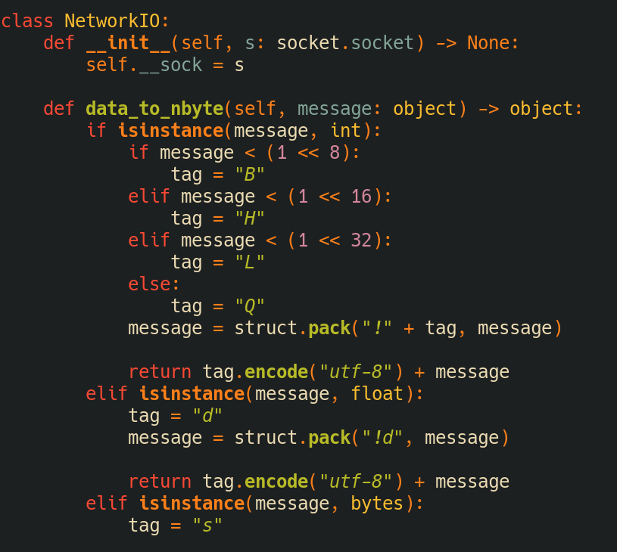
收送
sharing
sharing
raw_data
stego_data
stego_data
write to file
wav_file
write to file
wav_file
TCP
sender
receiver

Slide 15
Stego (每個 Sample 的 LSB)
Channel = 1, Rate = 8000, Format = Int8
len = 12
1-0bf53ca7dd
0x00001100
8 * 12 Sample
8 Sample

Slide 16
優點
與圖片比較
  人對圖像比較敏銳,藏在聲音比較不易備察覺
    圖片可以整張一直看, 聲音只能聽一個瞬間
    Cyber warfare: steganography vs. steganalysis (圖片的 LSB 容易備察覺)
  Signal-to-noise ratio
不容易被破解, 因為secret sharing -> 需要攔截一定的通話 (threshold)
  (要講多個 recv)

Slide 17
On Going
RTSP: ffmpeg

Slide 18
簡介最後, 鮮血細節

