Slide 1
Mobile IPv6 趨勢介紹

Slide 2
Mobile IP and its Variants
Mobile IPv4 (MIPv4)
MIPv4
Low-Latency Handover for MIPv4 (FMIPv4)
Regional Registration for MIPv4 (HMIPv4)
Mobile IPv6 (MIPv6)
MIPv6
Fast Handover for MIPv6 (FMIPv6)
Hierarchical MIPv6 (HMIPv6)

Slide 3
MIPv4: Overview
MIPv4 Nodes
MN (Mobile Node): Host
CN (Correspondent Node): Host
HA (Home Agent): Router
FA (Foreign Agent): Router
MIPv4 Address
HoA (Home Address): MN
CoA (Care-of-Address): FA

Slide 4
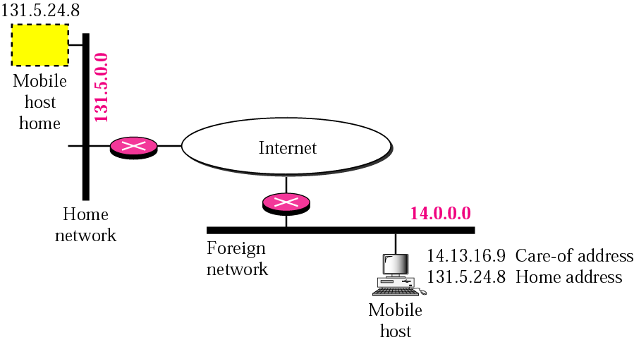
Home Address (HoA) and Care-of Address (CoA)

Slide 5
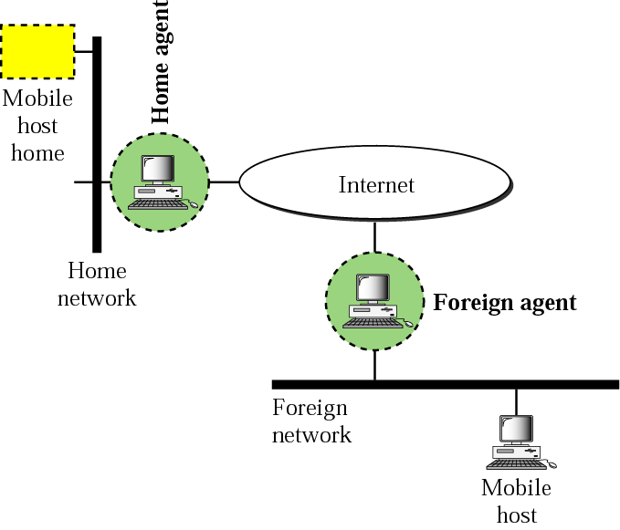
MIPv4 Agents
Home Agent (HA) & Foreign Agent (FA)

Slide 6
MIPv4: Control Operations
Agent Discovery
MN ⬄ FA (CoA)
ICMP Agent Solicitation & Advertisement
Registration to HA (via FA)
MN ⬄ FA ⬄ HA
Over UDP (destination port 434)
Data Tunneling
CN => HA (HoA) => FA (CoA) => MN
IP-in-IP Tunneling, ..

Slide 7
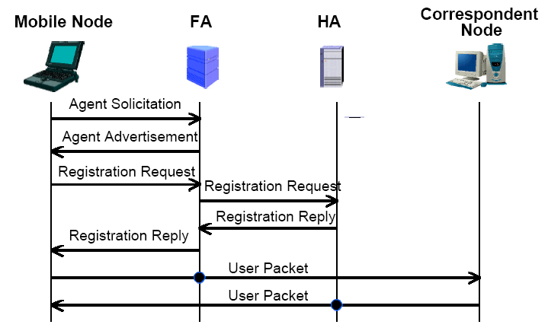
MIPv4: Control & Data Flows

Slide 8
Mobile IPv6 (MIPv6)
MIPv6 = MIPv4 + IPv6
Major Differences from MIPv4
FA in MN
No FA for MIPv6
CoA: IP address of MN
By DHCPv6 or IPv6 Stateless Auto-Configuration
Route Optimization
To solve the “Triangular Routing” Problem
Provided by default
MN ⬄ CN

Slide 9
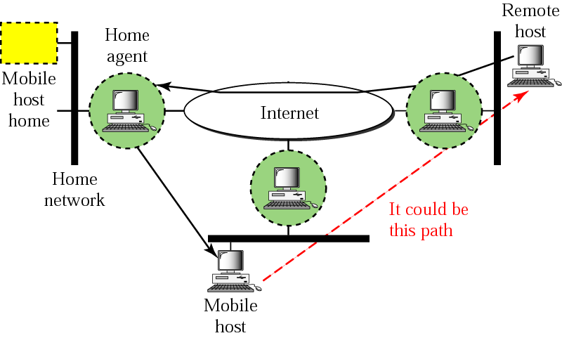
MIP: Triangular Routing Problem

Slide 10
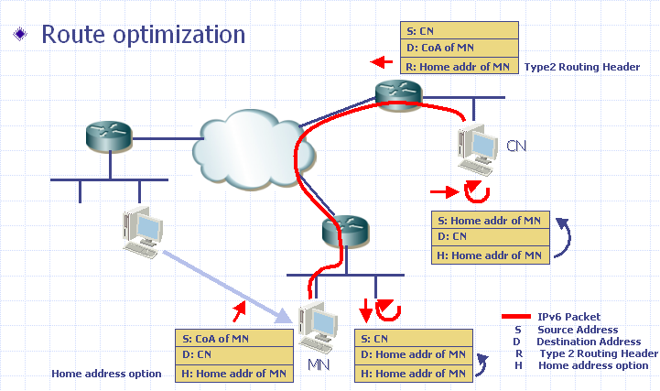
MIPv6: Route Optimization

Slide 11
MIPv6: Binding Update
Binding Update to HA
Using IPSEC: MN and HA have a security association
AH (Authentication Header)
ESP (Encapsulating Security Payload)
Binding Update to CN
Return Routability (RR) procedure
For Security
Binding Update (BU) procedure
Route Optimization

Slide 12
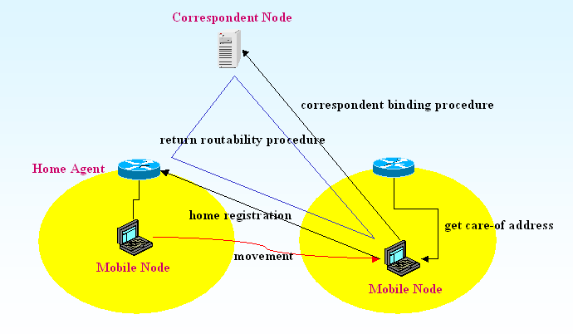
MIPv6: Binding Update (Cont.)

Slide 13
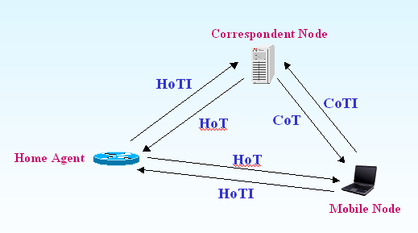
MIPv6: RR (Return Routability)

Slide 14
MIPv6: Changes to IPv6
New IPv6 Protocol (Header)
Mobility Header: a new IPv6 extension header
To carry MIPv6 Binding Update messages
How is in the MIPv4 ?
New Option in Destination Option Header
Home Address Option
New Type in Routing Header
Type 2 Routing Header
New ICMP Messages
ICMP HA Address Discovery Request/Reply
ICMP Mobile Prefix Solicitation/ Advertisement

Slide 15
References
Mobile IP

