Slide 1
A Dynamic VPN Architecture for Private Cloud Computing
2011 Fourth IEEE International Conference on Utility and Cloud Computing
Wen-Hwa Liao, Shuo-Chun Su
Tatung University

Slide 2
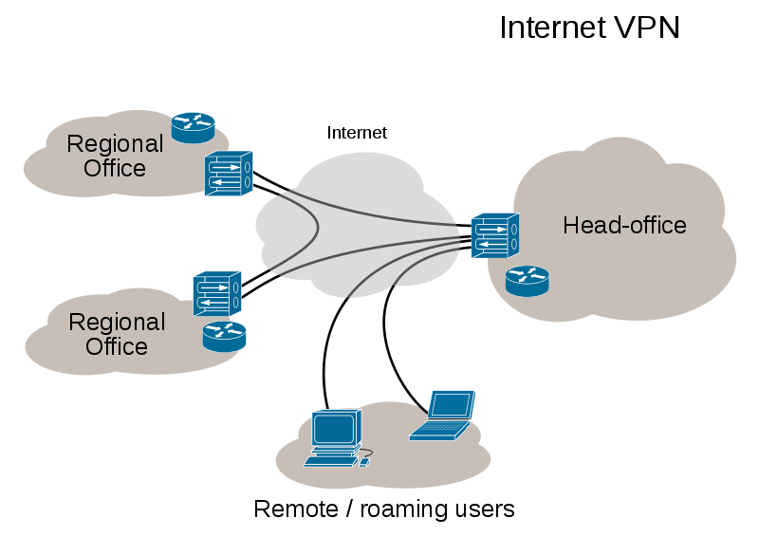
Virtual Private Network(VPN)
A virtual private network extends a private network across a public network, such as the Internet.
Technical
  Tunneling
  Encryption & Decryption
  Key management
  Authentication

Slide 3
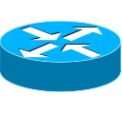

VPN Framework (Full-Mesh)
Every node is connected directly to others.
Advantage
  Shortest route
  No bottleneck
Disadvantage
  Each gateway(GW) must have an Internet key exchange(IKE) policy for each of the other GWs
  Can not traffic control
Internet
Gateway
VPN tunnel

Slide 4


VPN Framework (Hub-and-Spoke)
Every GWs connects to Hub-GW.
Advantage
  Each GW needs only one IKE policy to communicate with all other GWs.
  Traffic control
Disadvantage
  Delay
  bottleneck
Hub-GW
Internet
Gateway
VPN tunnel

Slide 5
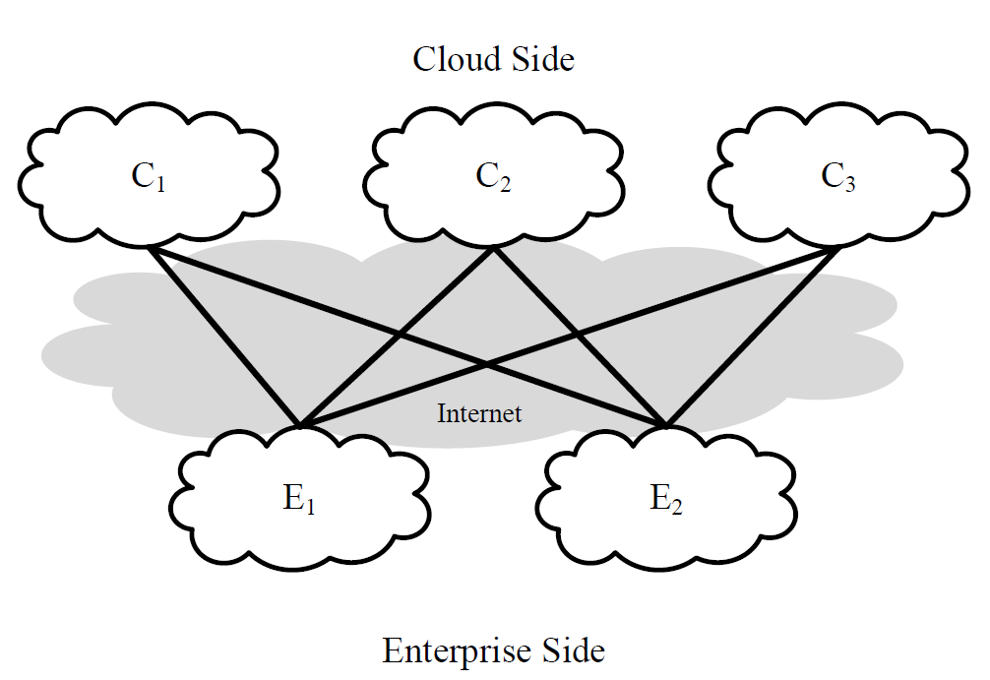
VPN Framework (Bipartite)
Based on hub-and-spoke and full-mesh
The corporation and the cloud service provider can be deemed as spokes under the network management of hub-GW.

Slide 6
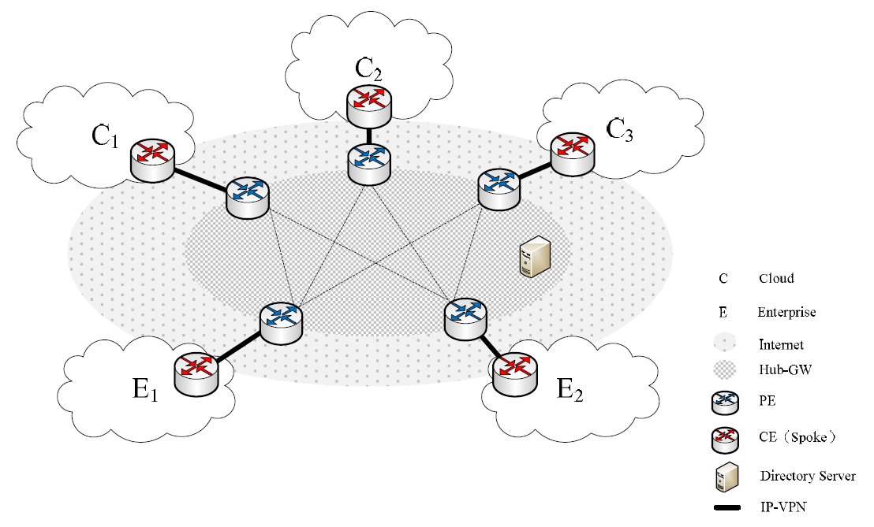
System Architecture
CE：Customer Edge
PE：Provider Edge

Slide 7
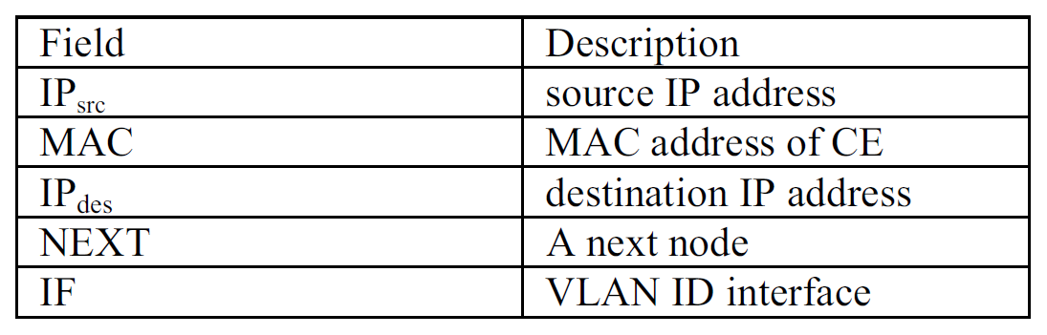
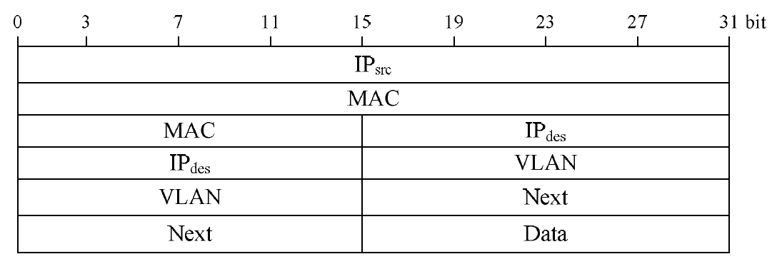
Packet Format
Connection between CE and PE

Slide 8
Exchange modes
CE_VLAN_request
  Establishing VLAN
CE_VLAN_response
  VLAN ID
CE_MAC_request
  Querying about permission for connection
CE_MAC_response
  Checking in the database whether the connection is permitted
CE_MAC_terminate
  Delete the VLAN ID for connecting

Slide 9
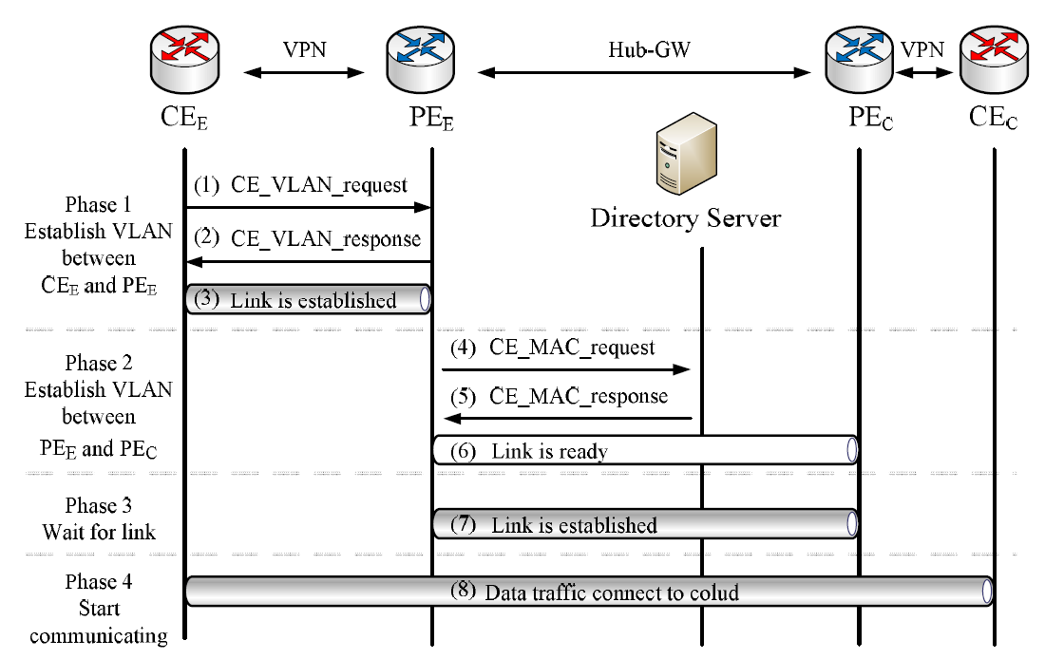
Process of adding a new connection

Slide 10
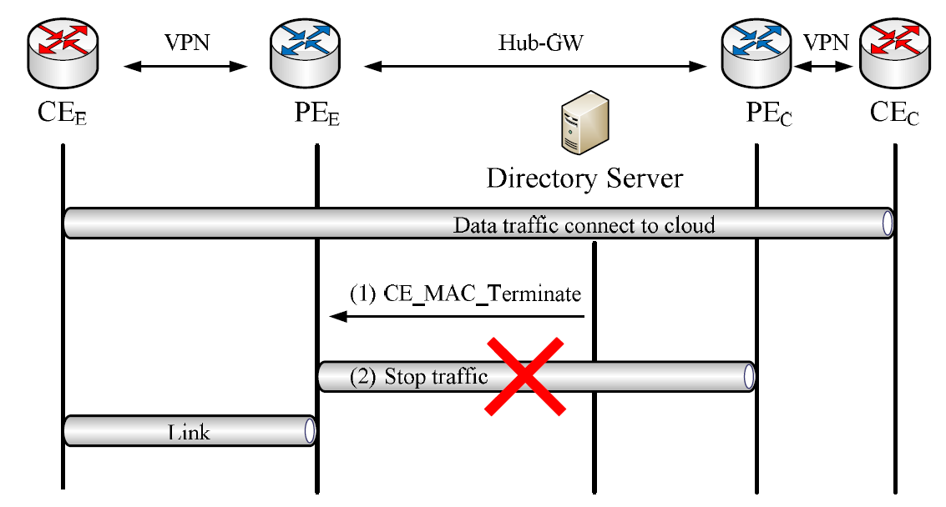
Process of erasing a connection

Slide 11
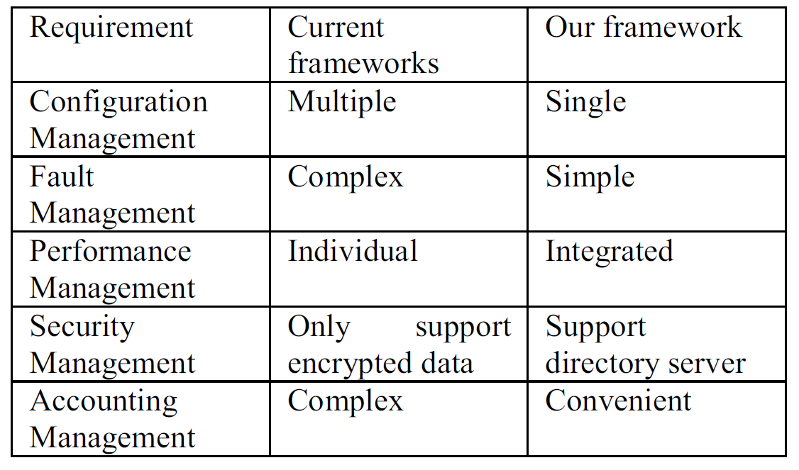
Analysis Result

Slide 12
Conclusion
The user needs only to connect hub-GW by using VPN like PPTP, IPsec or SSL without having to implement a complex network framework.
The management of hub-GW uses bipartite.
Needing to maintain extra table.

