Slide 1
Long-haul Transport Protocols
Presenter: Crystal

Slide 2
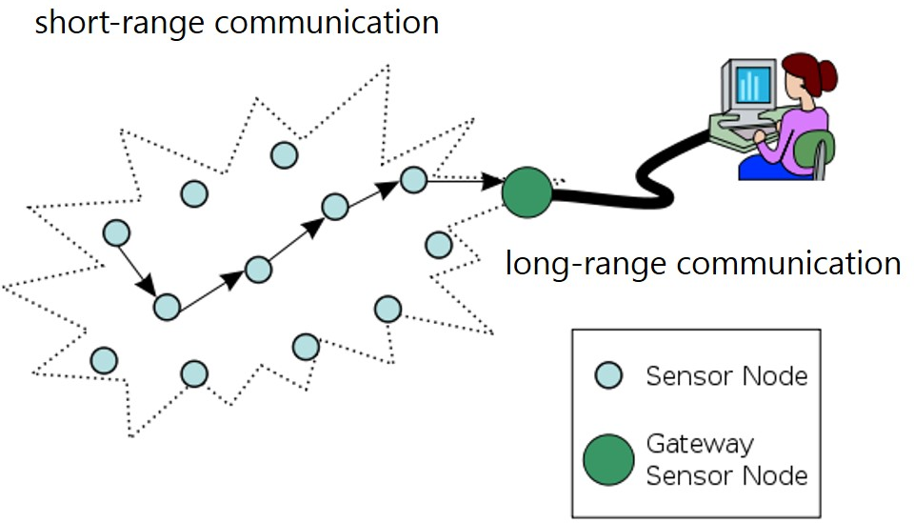
Motivation
A survey of long-haul transport protocols for wireless sensor networks gateways

Slide 3
Transport Protocols
TCP (Transmission Control Protocol)
UDP (User Datagram Protocol)
DCCP (Datagram Congestion Control Protocol)
SCTP (Stream Control Transmission Protocol)
MPTCP (Multipath TCP)

Slide 4
TCP (Transmission Control Protocol)
TCP guarantees that each segment will be sent to its destination, even with occasional occurrence of segment loss and unordered delivery.
Features:
  Retransmission mechanism for transmission failure
  Network congestion control mechanism
Notes:
retransmission mechanism is also implemented to recover lost segments and remove duplicate segments.

Slide 5
UDP (User Datagram Protocol)
UDP provides application multiplexing (via port numbers) and integrity verification (via checksum), but it does not handle any transmission failure.
Features:
  No assurance mechanism

Slide 6
DCCP (Datagram Congestion Control Protocol)
DCCP is a successor of UDP.
Features:
  Unreliable flows of datagrams
  Network congestion control mechanism
  Acknowledgement mechanism
Congestion Control Identifiers (CCIDs) : congestion control algorithms
  CCID 2 : TCP-like algorithm
  CCID 3 : TCP-Friendly Rate Control (TFRC)
  CCID 4 : TCP-Friendly Rate Control for Small Packets (TFRC-SP)
Notes:
CCID 4 experiment use 1500 bytes
Acknowledgement mechanisms communicating packet loss and ECN information.

Slide 7
SCTP (Stream Control Transmission Protocol)
SCTP is message-oriented (similar to UDP), while it also supports reliable, in-sequence transport of messages with congestion control (similar to TCP).
Features:
  Multi-streaming
  Multi-homing
  Cookie mechanism for association authentication
  Selective ACK
Notes:
The cookie mechanism aims to avoid Denial-of-Service attacks, which were found to exploit the vulnerability of three-way handshakes of TCP.
During the association establishment, the client and the server of SCTP can negotiate the number of stream in an association.
可以選擇開啟多少個stream

Slide 8
MPTCP (Multipath TCP)
Without modifying regular TCP operating, it can establish multiple TCP paths between a sender and a receiver.
Features:
  Multi-streaming
  TCP Option field for connection setup and adding subflows
  Data sequence mapping for in-order delivery
Notes:
mapping from the subflow sequence number to the data sequence number

Slide 9
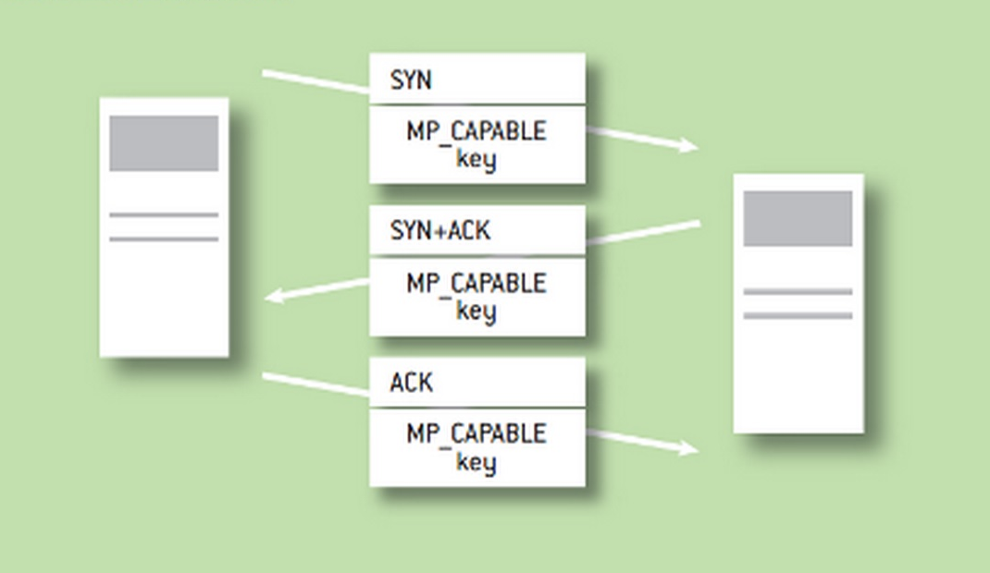
MPTCP – Establish Connection
An MPTCP connection is established by using the three-way handshake with TCP options to negotiate its usage.
A
MP_CAPABLE : supports MPTCP
Key : for security purposes
B

Slide 10
MPTCP – Add Subflows
Corresponding MPTCP connection must be uniquely identified on each end host.
Use regular TCP option for joining the corresponding MPTCP

Slide 11
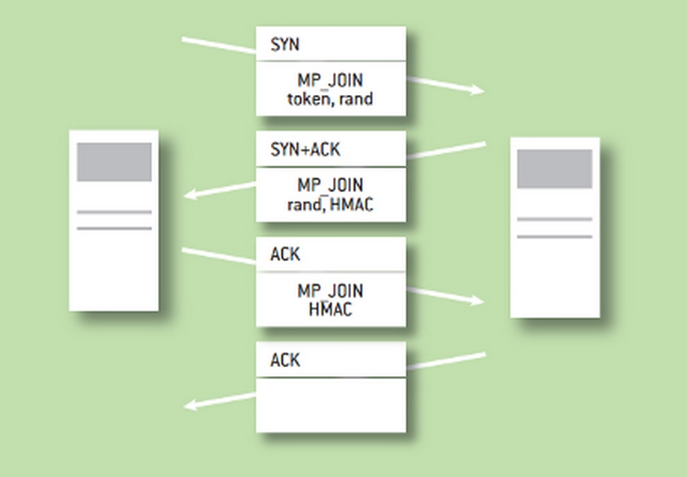
MPTCP – Add Subflows (cont.)
MP_JOIN token : for existing MPTCP connection authentication
rand (key) : for security purposes
HMAC (hash-based message authentication code) : for security purposes
MP_JOIN
Token, rand-A
MP_JOIN
rand-B, HMAC-B
A
B
MP_JOIN
HMAC-A

Slide 12
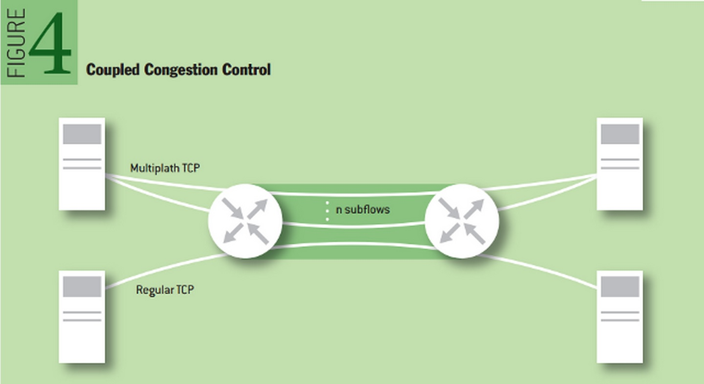
MPTCP – Transmit Data
Data transmitted over one subflow can be retransmitted on another to recover from losses.

Slide 13
MPTCP – Transmit Data (cont.)
After the connection is set up, absolute data sequence number will be added into the TCP Option for reassembly.
However, the middleboxes, such as firewalls , NATs, and load balancers, would modify the TCP header or the payload of passing TCP segments.
Data sequence mapping:
  relative subflow sequence number
  data-level length

Slide 14
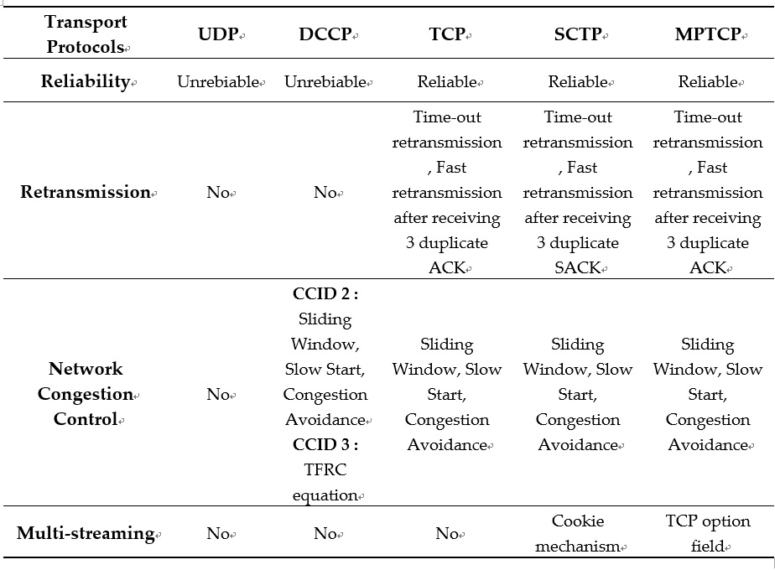

Slide 15
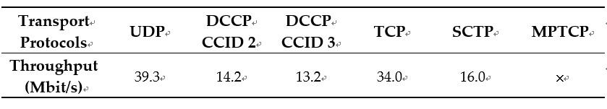
Performance
Experiment Environment : Raspberry Pi (Model B+, Raspbian Jessie)
Measuring Tool : netperfmeter (network performance meter)
UDP achieves the highest throughput 39.3 Mbit/s.
DCCP gets the lowest throughput 13.2 Mbit/s.
Notes:
1980
2001

Slide 16
Conclusion
UDP and DCCP are suitable for applications with timing constraints, such as Voice over IP (VoIP).
TCP, SCTP and MPTCP should be used for accurate delivery.
Considering the performance of transmitting single type of data, TCP is a better choice than SCTP.
In view of multiple data delivery, SCTP and MPTCP are the choices for better performance.

