Slide 1
A Real World Evaluation of Push to Talk Service Over IMS and LTE for Public Safety Systems
The IEEE WiMob 2014 Workshop on Emergency Networks for Public Protection and Disaster Relief
Alhad Kuwadekar , Khalid Al-Begain

Slide 2
Outline
Introduction
Public Safety System Requirements
IP Multimedia Subsystem(IMS) Architecture
Open Mobile Alliance(OMA) PoC Architecture
Implementation
Result
Conclusion

Slide 3
Introduction
Since 1997 Push to Talk has been deployed over Terrestrial Trunked Radio (TETRA).
TETRA is a narrow band and too expensive to install , operate and maintain.
Governments around the world are looking to replace TETRA with LTE for next generation broadband public safety networks.
Open Mobile Alliance (OMA) standardize the PoC specifications and it is a part of the 3GPP IMS architecture.
* PoC : Push-to-Talk over Cellular
* 3GPP : 3rd Generation Partnership Project
* IMS : IP Multimedia Subsystem
Notes:
Generic Routing Encapsulation (GRE) is a tunneling protocol developed by Cisco Systems that can encapsulate a wide variety of network layer protocols inside virtual point-to-point links over an Internet Protocol network.

Slide 4
Public Safety System Requirements
Call time setup is between 0.3 to 1.0 seconds.
The background noise needs to be suppressed as much as possible.
A priority scheme based on the severity of the job.
The network needs to have sufficient levels of redundancy.
Has the Direct Mode Operation.
Has defined a minimum Grade of Service under normal , natural disaster and busy hour scenario.
Provide security features.

Slide 5
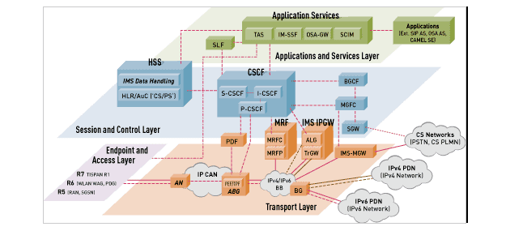
IMS Architecture
➢ HSS : Home Subscriber Server
➢ CSCF : Call Session Control Function
PCSCF : Proxy-CSCF
I-CSCF: Interrogating-CSCF
S-CSCF: Interrogating-CSCF
Courtesy of ipv6.com

Slide 6
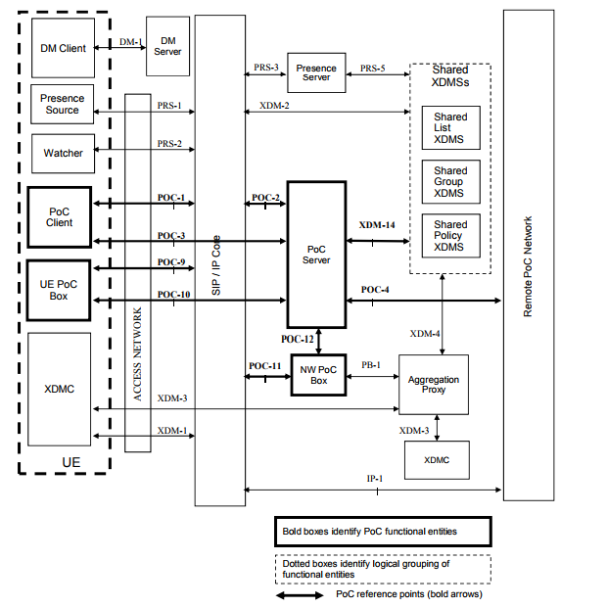
OMA PoC Architecture
* DM : Device Managent
* XDMS : XML Document Management Server
* UE : User Equipment
* SIP : the Session Initiation Protocol
* NW PoC Box : Network PoC Box
* XDMC : XML Document Management Client

Slide 7
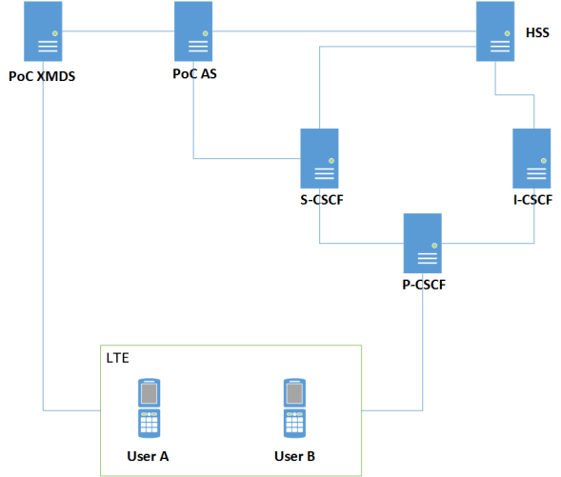
Implementation
XMDS : built on PHP running on CentOS
Cell Phone : Samsung Galaxy S4
App : GenXfone
Network : the EE UK 4G LTE network
Measurement : 4 PTT user equipment and 200 calls were made on Saturday for each scenario

Slide 8
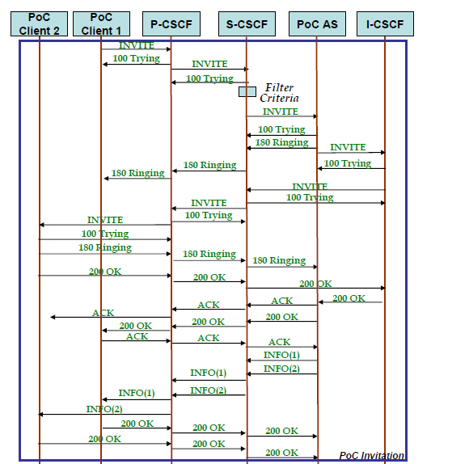
Resource : Implementation of IMS-based PoC Service with Context-Aware Interaction

Slide 9
Results
Scenario 1 : No traffic on the IMS network.
Result : The average the time taken for a PTT call was 2.556 seconds.
Scenario 2 : An IMS traffic generator called Seagull was used to generate traffic on the IMS network. The number of calls generated by Seagull was gradually increased from 100 to 2000 per second.
Result : After 300 calls it started to slow down , and from 1500 to 2000 calls the failure rate was 1/10.
Scenario 3 : Test how the PTT system performs at an event with over 10,000 people.
Result : The failure rate was 100% over LTE network

Slide 10
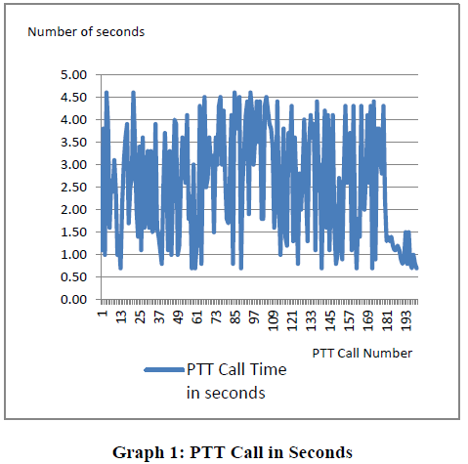
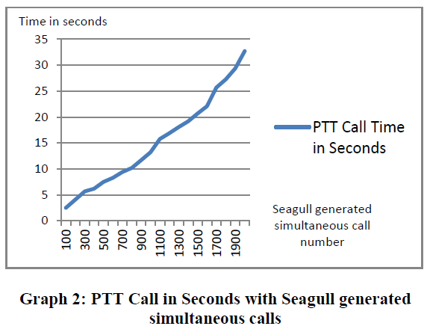
Scenario 1 :
Scenario 2 :

Slide 11
Conclusion
The performance of the PTT service drops significantly by multiple simultaneous calls.
It is recommended that a separate IMS should be setup for PTT service to work efficiently.
The PTT fails to operate on a shared network space when there are thousands of users in the same cell space.
A reserved channel space is made available to the public safety services. This channel space should not be allocated to any member of public.

